Slide 1
NEALLT 2016
Motivating Students with Media, Games, and Style
Gettysburg College
March 18-20
Thinking through the Language Center
Role & Design
Luba Iskold & Tom Sciarrino
Muhlenberg College
Notes:
This template can be used as a starter file for presenting training materials in a group setting.
Sections
Right-click on a slide to add sections. Sections can help to organize your slides or facilitate collaboration between multiple authors.
Notes
Use the Notes section for delivery notes or to provide additional details for the audience. View these notes in Presentation View during your presentation.
Keep in mind the font size (important for accessibility, visibility, videotaping, and online production)
Coordinated colors
Pay particular attention to the graphs, charts, and text boxes.
Consider that attendees will print in black and white or grayscale. Run a test print to make sure your colors work when printed in pure black and white and grayscale.
Graphics, tables, and graphs
Keep it simple: If possible, use consistent, non-distracting styles and colors.
Label all graphs and tables.

Slide 2
Presentation Outline:
• Introduction & Background
• Project Goals
• Methodology
• Findings
• Technology
• Discussion

Slide 3
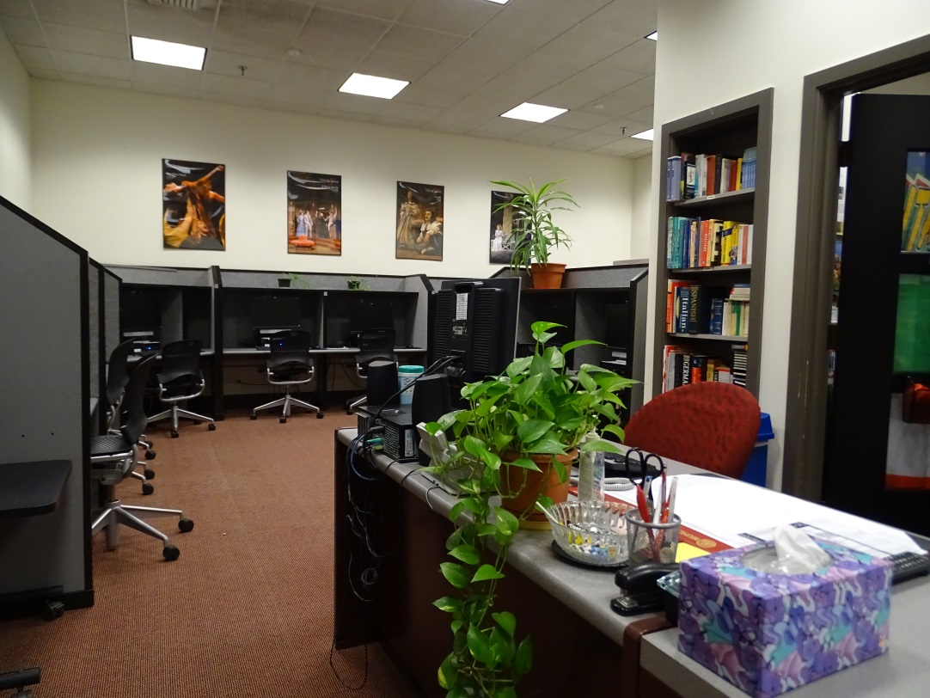
LLC @ Muhlenberg: History
• Muhlenberg College has a FL requirement
• We currently offer eight languages & five major/minor programs
• Our LLC was stablished in 1985-served for 30 years
• Designed for audio-lingual methodology & individual learner
Notes:
Add pictures here

Slide 4
LLC @ Muhlenberg: Looking Back
What were we doing? How did we attract students and faculty?
• duplicating audio and VHS tapes
• converting materials to CD & DVD formats
• leading faculty development initiatives
• producing faculty-developed MM materials for class
• allowing for student access to international keyboards
• offering editing/proofing tools for multiple languages
• providing access to TB materials, including video & labs
• delivering SCOLA & Dish Network programming
• assigning 10% of the grade for work in the LLC
• organizing tech workshops for faculty & for students
• promoting the uses of social media through student-led workshops
• making flyers for numerous academic & extra- curricular events
• accommodating for individual LLC sessions for faculty & for students

Slide 5


Why should we worry about the ‘existential threat’?
What has changed & Why redesign?

Slide 6
What has changed??? Do we still need the LLC?
Reviewing the List:
• duplicating audio and VHS tapes
• converting to new CD & DVD format- yes, but much less
• leading faculty development initiatives
• producing faculty-developed MM materials for class
• allowing for student access to international keyboards
• offering editing/proofing tools for multiple languages
• providing access to TB materials, including video & labs
• delivering SCOLA & Dish Network programming- not necessary
• assigning 10% of the grade for work in the LLC
• organizing tech workshops for faculty & for students
• promoting the uses of social media through student-led workshops
• making flyers for numerous academic & extra curricular events
• arranging individual LLC sessions for faculty & for students
Notes:
Use editing to mark up/delete irrelevant services

Slide 7



What is changing???
• Technology is transforming daily life
• The World is changing
• The College’s mission is changing
• Campus culture is changing
• Students are changing
• Textbooks are changing
• Approaches to teaching are changing
Notes:
Add pic of a new space @at berg

Slide 8

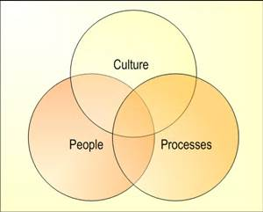

Project Goal:
Changing the ‘threat’ to an opportunity
Notes:
Since Campuses are changing- we can change the threat into an opportunity

Slide 9

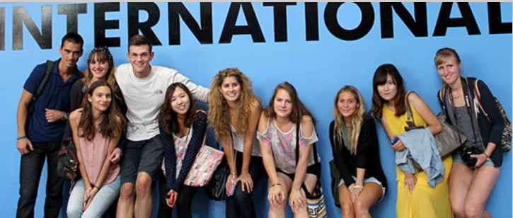
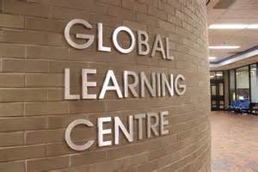
From Language Lab LLC /LRC GLC
Goal: Changing the ‘threat’ to an opportunity for …
• increasingly global learning
• curricular & co-curricular interdisciplinarity
• collaborative learning culture
• serving diverse student population
• service learning experiences
Notes:
Add pictures here

Slide 10
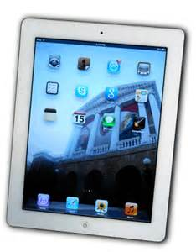
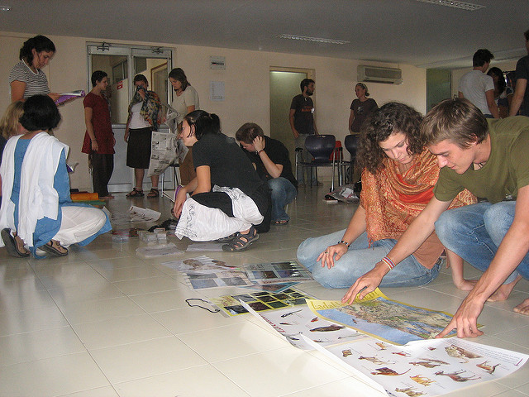
What’s the Plan? What else can we do?
• Engage international students
• Provide resources for short-term study abroad programs
• Accommodate for students with special needs
• Organize face-to-face conversation partnerships
• Connect students with local communities
• Facilitate digital connections
• Pilot innovative technologies
Notes:
Is the Language Center still a place to explore technological innovation?

Slide 11
Thinking about the space that would help us reach our goals: Methodology
• Observing/documenting current use of the LLC
• Reviewing the relevant literature
• Attending Webinars
• Engaging students in online research of LC at other schools
• Visiting other institutions
• Inviting guest speakers
• Engaging faculty: Faculty Focus Groups
• Engaging students: Student Focus Groups
• Faculty Survey
• Student Survey
• Working with various departments on campus

Slide 12
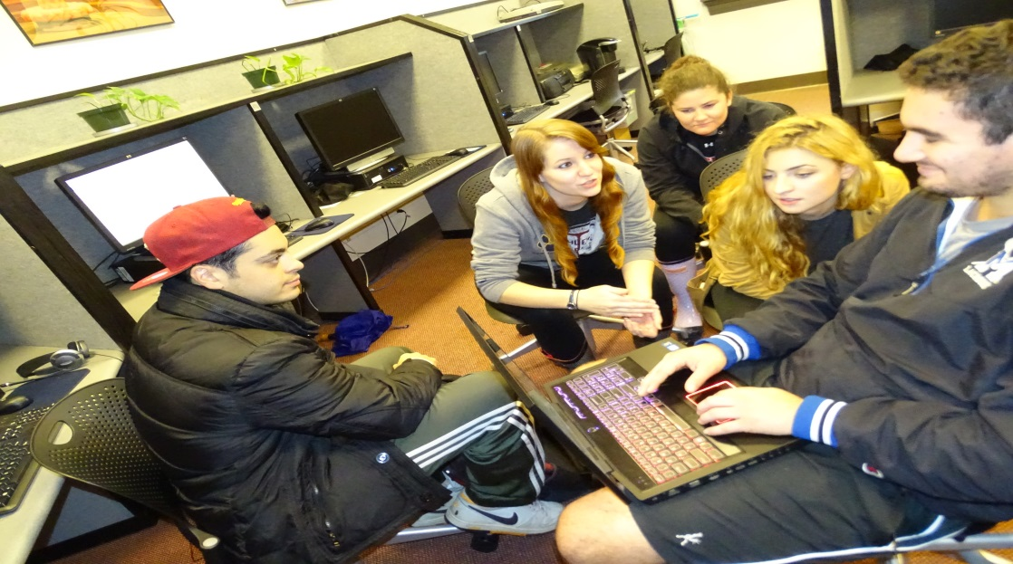
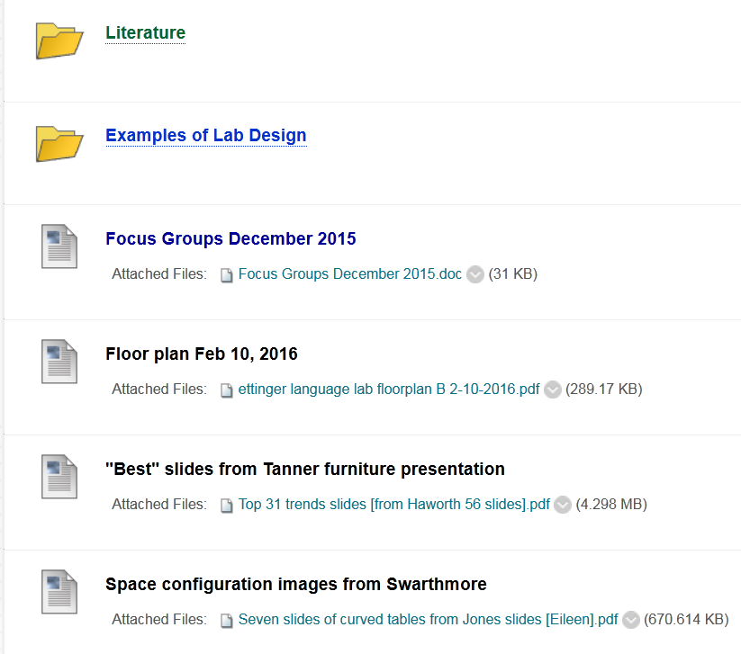
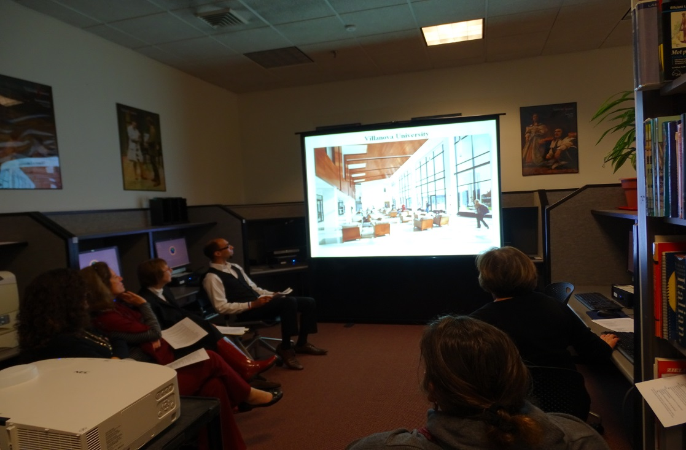
LMS “course,”
Focus Groups, Surveys, Vendor Presentations

Slide 13
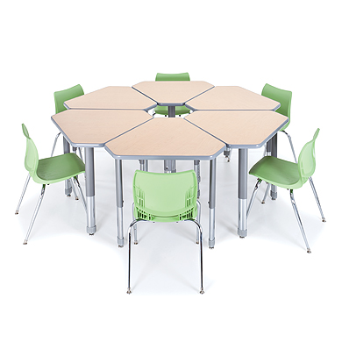
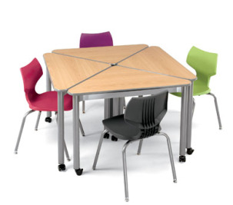
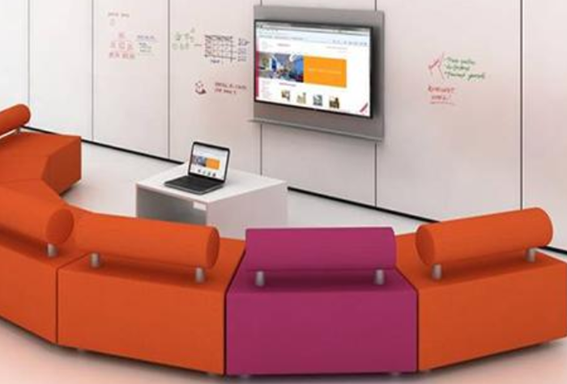
Project Goals: What kind of space do we envision? Space Design
Flexible & adaptable
• Inviting
• Multi-purpose
• Uncluttered
• Well-lit
• Flexible
• Visible
• Potential for
spontaneous
re-configuration

Slide 14
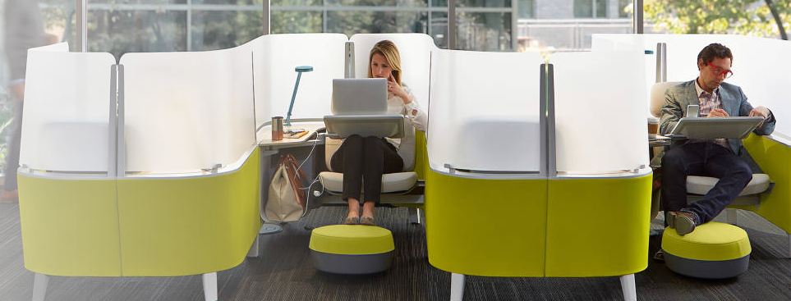
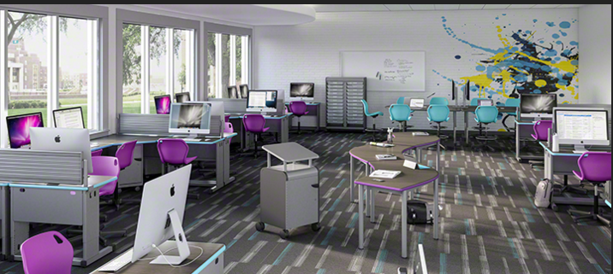
Project Goals: What kind of space do we envision? Space Use?
• Offers opportunities for
face-to-face & digital interaction
• Provides a combination of formal
& semi-formal settings
• Facilitates a variety of modes of
social exchange
• Encourages collaboration
• Enhances digital learning and
global interaction
connections
Class/workshop: 24 seats
Collaborative Spaces 2-6 seats
Small group: 8-10 seats
Quiet spaces/Individual users

Slide 15
Faculty Survey: Pedagogical Needs
Judgments were made on a 5-point scale (5 = strongly agree, 1 = strongly disagree); n = 14
Question | Mean
1. CUE seminars and meetings | 3.56
2. Small classes | 4.00
3. Language Club meetings | 4.72
4. Language Conversation Table | 4.67
5. Conversation Partnership sessions | 4.67
6. Tutoring sessions | 4.17
7. Collaborative assignments for class | 4.61
8. Group workshops for students | 4.44
9. International TV Programming | 3.94
10. International News | 3.89
11. Group Teleconferencing | 4.67
12. Occasional class meetings | 3.78

Slide 16
Faculty Survey: Design
Judgments were made on a 5-point scale (5 = strongly agree, 1 = strongly disagree); n =
Question | Mean
1. Encourages student interaction | 4.67
2. Accommodates for large-groups | 3.67
3. Enables small-group activities | 4.83
4. Provides privacy and quiet spaces for individual learners | 4.72
5. Allows for learning and interaction in a semi-formal setting | 4.50
6. Permits comfortable student gathering or studying w/o technology | 4.28
7. Can be re-purposed/reconfigured relatively easily | 4.78
8. Can be easily upgraded with emerging technologies in the future | 4.89
9. Visible from hallway | 4.11

Slide 17
Faculty Survey: Technology
I will most likely use in the LLC: | Yes | No
1. Desktop PC | 71% | 29%
2. Laptop PC | 81% | 19%
3. iPad | 53% | 47%
4. Desktop Mac | 23% | 77%
5. Laptop Mac | 62% | 38%
6. Bring my own device | 47% | 53%

Slide 18
Faculty Survey: Technology
My students will most likely use in the LLC | Yes | No
1. Desktop PC | 76% | 24%
2. Laptop PC | 73% | 27%
3. iPad | 73% | 27%
4. Desktop Mac | 64% | 36%
5. Laptop Mac | 86% | 14%
6. Bring my own device | 88% | 12%

Slide 19
Budget Proposal: Hardware
Permanent Stations with Laptops (8 total):
6 PC Laptops
2 Mac Laptops
Loan Laptops (16 total):
10 PC Laptops
6 Mac Laptops
___________________________________
Total Laptops 24 (class size)
Loan iPads 10

Slide 20
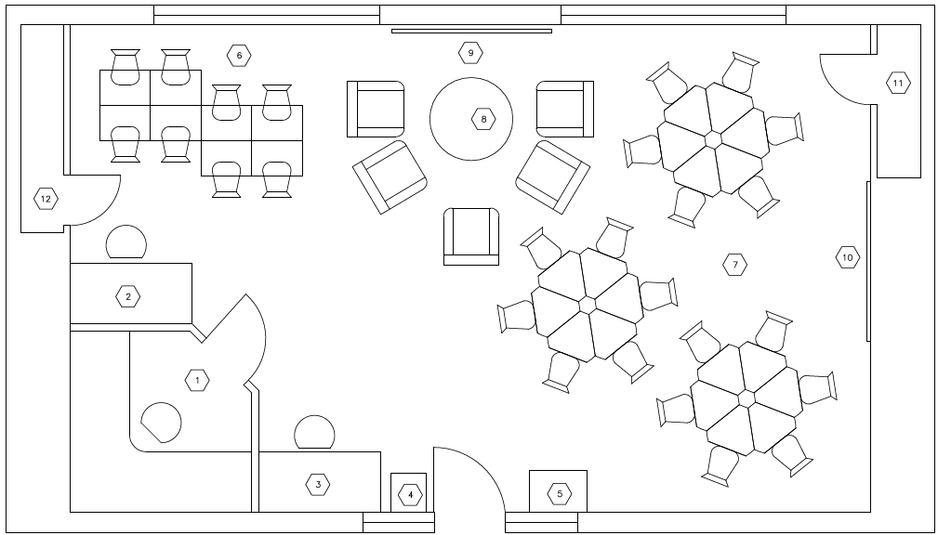
GLC Layout Legend (3/12/16)
1 | Lab Technician Office | 7 | Class/Workshop Area
2 | Presidential Assistant Desk | 8 | Social Space
3 | Student Worker Desk | 9 | Large LCD/TV Screen
4 | Printing Station | 10 | Projection Screen
5 | Coffee Table | 11 | Power/Tech Closet
6 | Individual Study Area | 12 | Storage Closet

Slide 21
Technology Review
• We looked at this renovation from three key areas
Faculty
Students
Peer institutions

Slide 22
Technology Review- Faculty
  The ways faculty currently teach
    Provide campus standard classroom tool set- “Techwall’
    Current lab still has value so we had to preserve the tools that were working
      Number of computers
      Student/Staff onsite support
  The ways faculty would like to teach
    Include video conferencing tools- Zoom, Skype
    Flexible learning space that can be easily reconfigured to meet individual faculty needs
    Interactive presentation tools- Epson interactive projector
    Integrated support for blended learning
  Expanded tool set
    Gaming- Virtual reality- Google, Oculus Rift
    Leverage new LMS (Canvas)

Slide 23
Technology Review- Students
  The ways students currently learn
    Provide campus standard classroom tool set
    Preloaded workstations for drop-in work
  The ways students would like to learn
    BYOD support- NovoPro, Mirroring 360
    Spaces for collaborative group work- 3 independent presentation locations
    Whiteboard space- SmartKapp
  Provide tools that expand what students learn
    Gaming- Virtual reality
    Leverage new LMS (Canvas)
    Space for viewing required films outside of the library

Slide 24
Technology Review- Outside World
    Studied what our peer institutions were doing
    Horizon Report- Mew Media Consortium and Educause
    Webinars
      Educause
      Online Learning Consortium
    Vendor recommendations

Slide 25
Contact Information:
Luba Iskold
Professor of Russian
Director Language Learning Center
Muhlenberg College
Phone: 484-664-3516
E-mail: iskold@muhlenberg.edu
Website:
http://www.muhlenberg.edu/main/academics/llc/faculty/russian/iskold.html
Thomas Sciarrino
Manager of Instructional Technology & Digital Learning
Muhlenberg College
Phone: 484-664-3457
E-mail: sciarrino@muhlenberg.edu

Slide 26
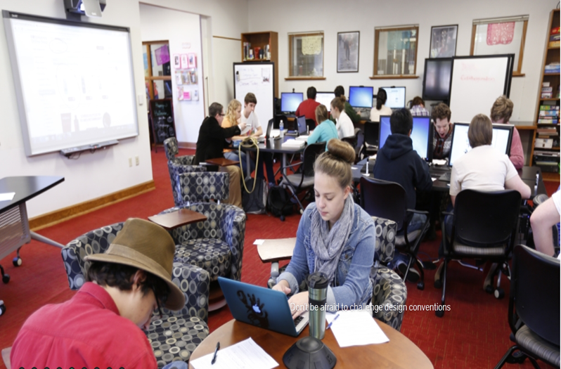
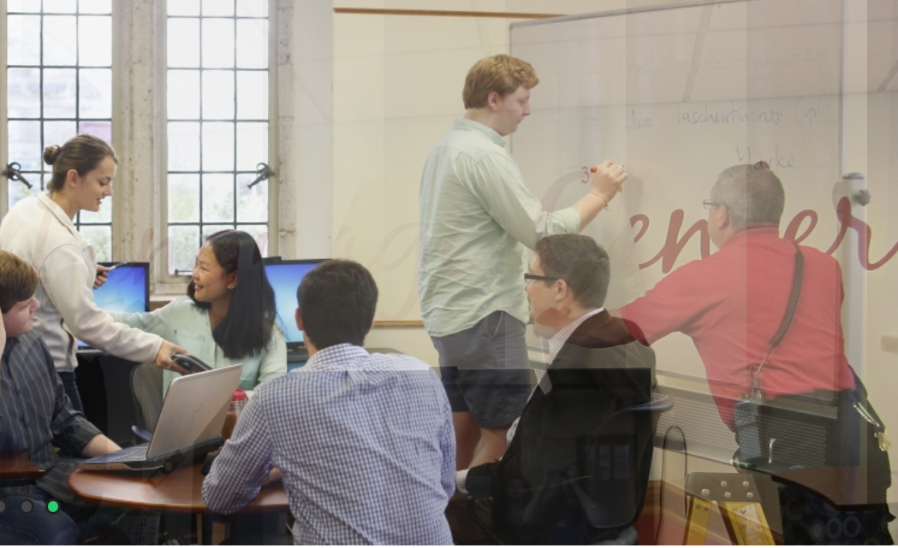
References
Kramsh, K. (2012). The Educational Promise of the Language Center in the Age of Globalization. Keynote, Yale University.
Kronenberg, F. (2014). Language Center Design and Management in the post- Language Llaboratory era. The ILLT Journal, 44(1).
Oblinger, D. (ed). Learning Spaces. EDUCAUSE, 2006.
Learning Spaces Collaboratory Webinars : Bonnie Sanborn, Dept. of Design & Environmental Analysis , Cornell University; Felix Kronenberg, Rhodes College
Van den Blink, C. Uses of Labs and Learning Spaces. EDUCAUSE, 2009

